Slide 1
VPL Product Overview

Slide 2
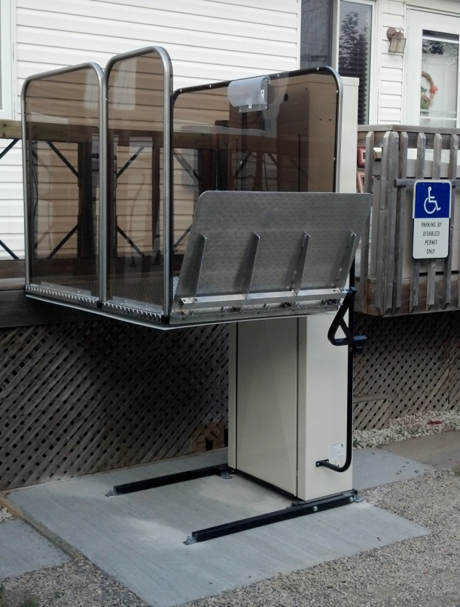
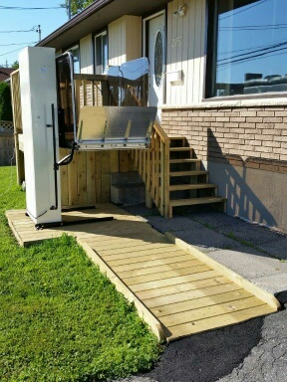
Premium Vertical Platform Lifts Collection
Product Code VPL-SH1-52-AC VPL-SH1-52-DC | Product Code VPL-SH1-72-AC VPL-SH1-72-DC | Product Code VPL-SH1-105-AC VPL-SH1-105-DC
Overall Footprint Including Ramp 52 1/4” x 74” | Overall Footprint Including Ramp 52 1/4” x 74” | Overall Footprint Including Ramp 52 1/4” x 74”
Lifting Height: 52 Inches | Lifting Height: 72 Inches | Lifting Height: 105 Inches

Slide 3
Premium Vertical Platform Lifts Collection
Specifications | Product Code VPL-SH1-52 | Product Code VPL-SH1-72 | Product Code VPL-SH1-105
Platform Size: Inside Outside | 34” x 54” 36” x 54” | 34” x 54” 36” x 54” | 34” x 54” 36” x 54”
Maximum Lifting Height: Weight Capacity: | 52” 750 lbs | 72” 750 lbs | 105” 750 lbs
Motor Drive | 1 hp AC and VDC Acme Screw Drive | 1 hp AC and VDC Acme Screw Drive | 1 hp AC (Only) Acme Screw Drive
Safety | Emergency Stop Safety Under – Pan Manual Lowering | Emergency Stop Safety Under – Pan Manual Lowering | Emergency Stop Safety Under – Pan Manual Lowering
Ramp | Manual Auto | Manual Auto | Manual Auto
What Separates Us From The Rest | Light Weight Aesthetically Pleasing Easy To Install Stainless Steel Hardware Polycarbonate side walls for added durability. Aluminum Platform Field reversible Left to Right, Right to Left & 90 degree (No Charge) Built to Last | Light Weight Aesthetically Pleasing Easy To Install Stainless Steel Hardware Polycarbonate side walls for added durability. Aluminum Platform Field reversible Left to Right, Right to Left & 90 degree (No Charge) Built to Last | Light Weight Aesthetically Pleasing Easy To Install Stainless Steel Hardware Polycarbonate side walls for added durability. Aluminum Platform Field reversible Left to Right, Right to Left & 90 degree (No Charge) Built to Last

Slide 4
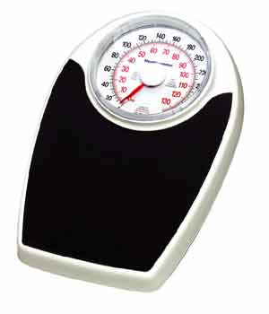
PREMIUM (54” Platform) Vertical Platform Lifts Lifting Heights Available 52”, 72” & 105”
Removable Top Cover & Front Cover For Ease Of Access
Up & Down Toggle & Emergency Stop Button
52” Unit only Weighs 350 lbs.
Stainless Steel Rails
Polycarbonate
UV protected
Side panels.
High Grade Powder
Coating
20” Autofold Ramp
Field Reversible - Side Panels are removable and can be re-positioned for 90 Degree on/off in minutes at no extra charge to you.
750 lb lifting capacity
Safety pan to prevent downward movement in case of an obstruction
Stainless steel Nuts & Bolts

Slide 5
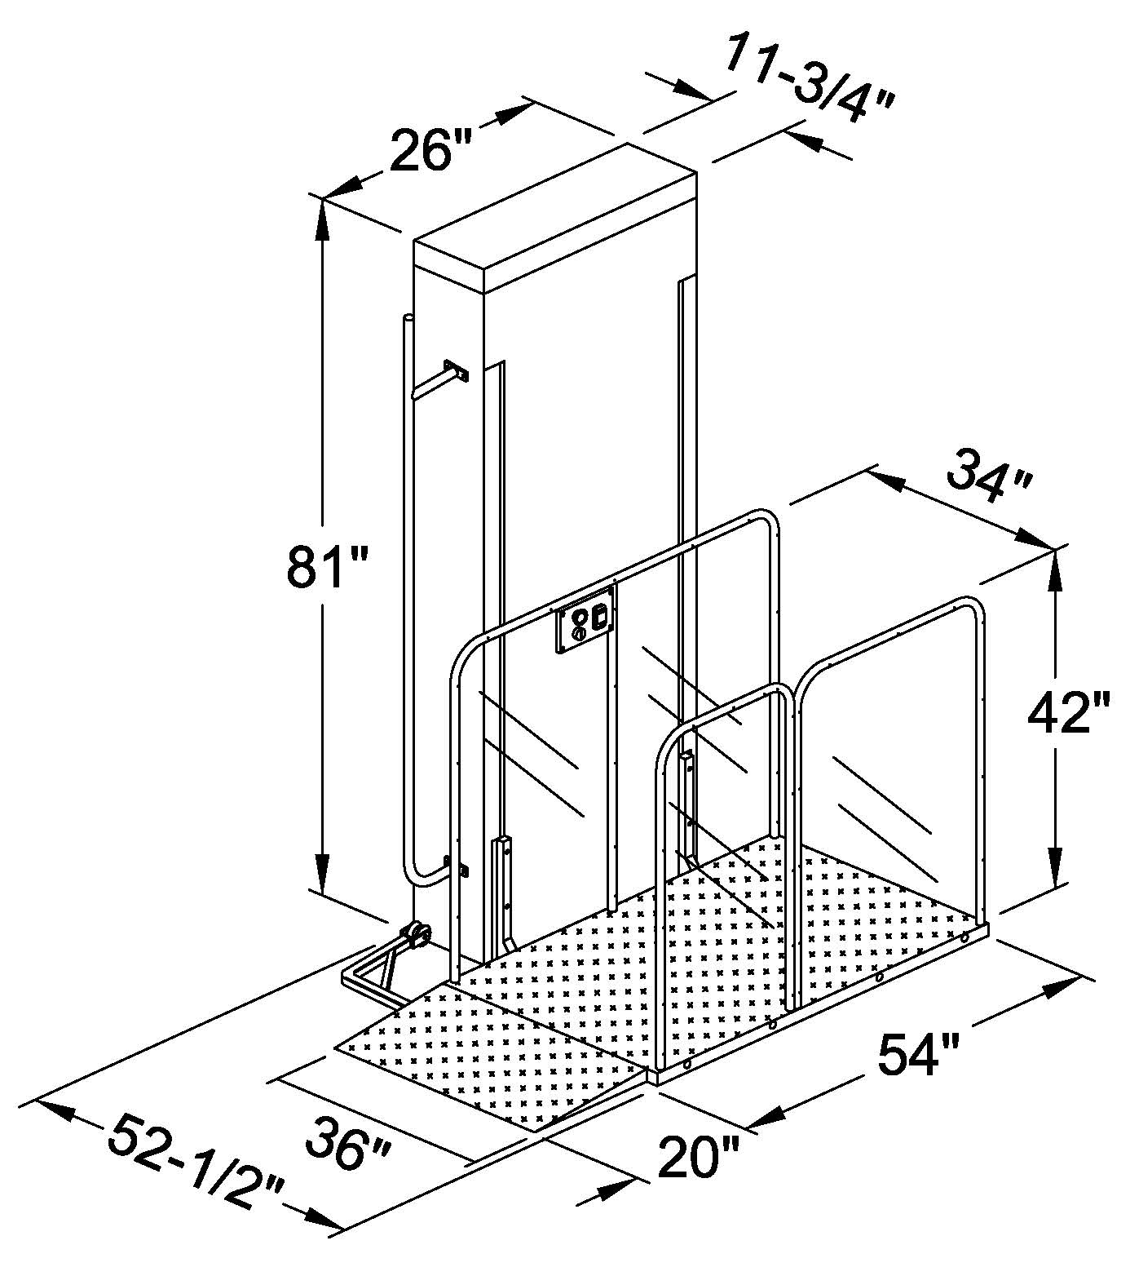
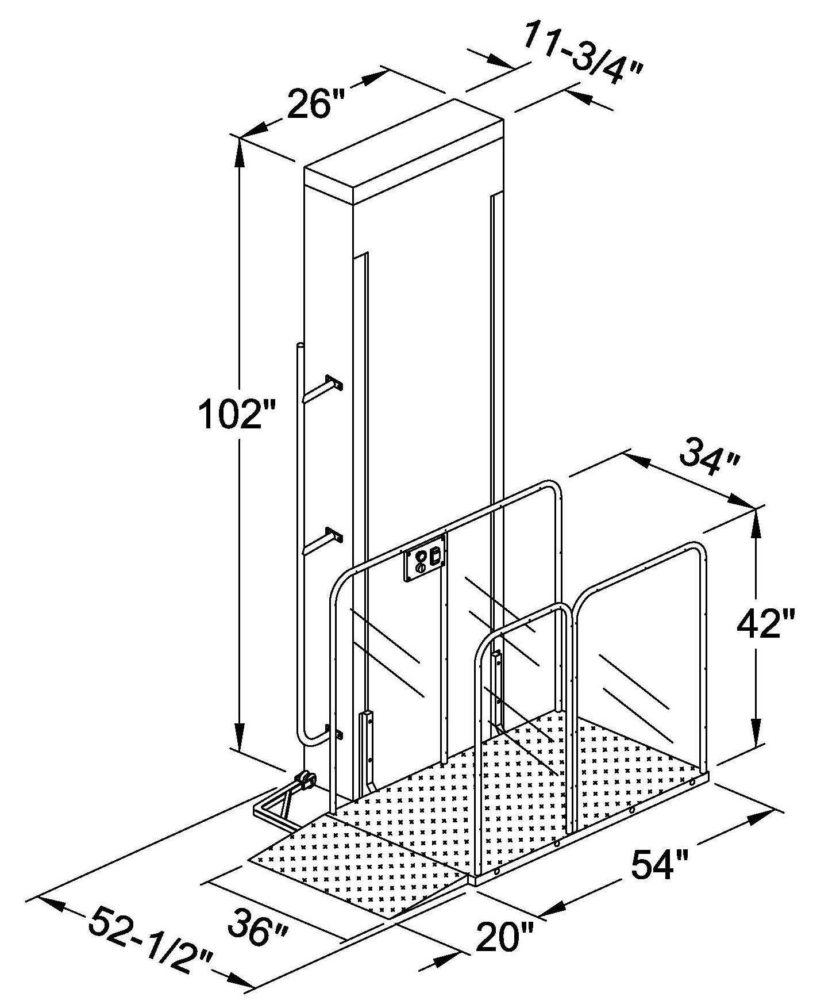
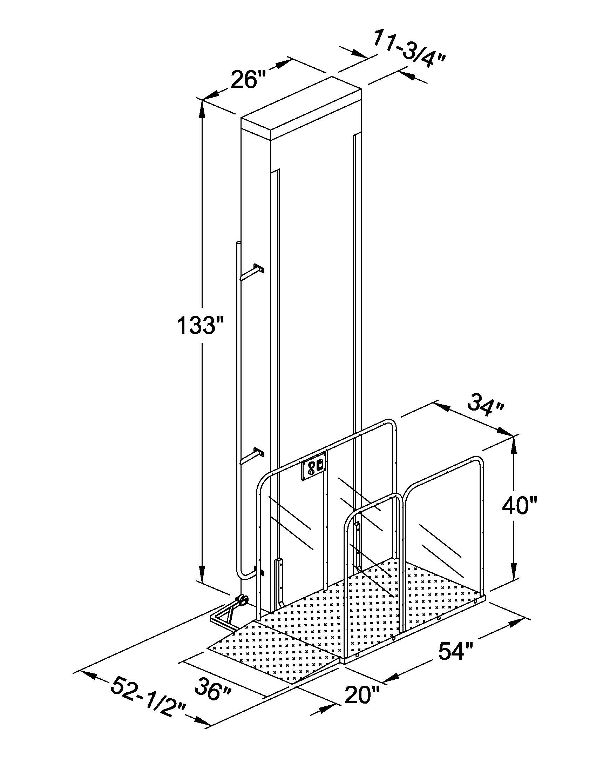
Premium Vertical Platform Lift Collection (3 units) Line Drawings With Dimensions Overall Footprint Including Ramp 52 ¼” x 74”
VPL-SH1-52-AC
VPL-SH1-52-DC
52” Travel >>>>>
VPL-SH1-72-AC
VPL-SH1-72-DC
72 “ Travel >>>>>
VPL-SH1-105-AC
105” Travel >>>>>

Slide 6
Premium Vertical Platform Lifts Product Codes & Description
Products Code | Description
VPL-SH1-52-AC | AC Inclinator Serenity Premium VPL, 36” x 54” Platform, 81” Tower Height, 52” Lifting Height, 750 lb Weight Capacity.
VPL-SH1-52-DC | DC Inclinator Serenity Premium VPL, Battery Operated VPL, 36" x 54” Platform, 81” Tower Height, 52” Lifting Height, 750 lb Weight Capacity. (Batteries Not Included)
VPL-SH1-72-AC | AC Inclinator Serenity Premium VPL, 36" x 54” Platform, 102” Tower Height, 72” Lifting Height, 750 lb. Weight Capacity
VPL-SH1-72-DC | DC Inclinator Serenity Premium VPL, Battery Operated VPL, 36 x 54” Platform, 102” Tower Height, 72” Lifting Height, 750 lb Weight Capacity. (Batteries Not Included)
VPL-SH1-105-AC & DC | AC Inclinator Serenity Premium VPL, 36 x 54” Platform, 135” Tower Height, 105” Lifting Height, 750 lb. Weight Capacity.
Please Note: The Inclinator Serenity Premium Vertical Platform Lifts come with an inside measurement of 34” Wide x 54” Long Aluminum Platform, with premium stainless steel side rails & polycarbonate panels. The Inclinator Serenity Premium Lift can be changed to a 90 degree access at no charge on site and can also be changed from a left hand tower to a right hand tower or visa versa on the job site.

Slide 7
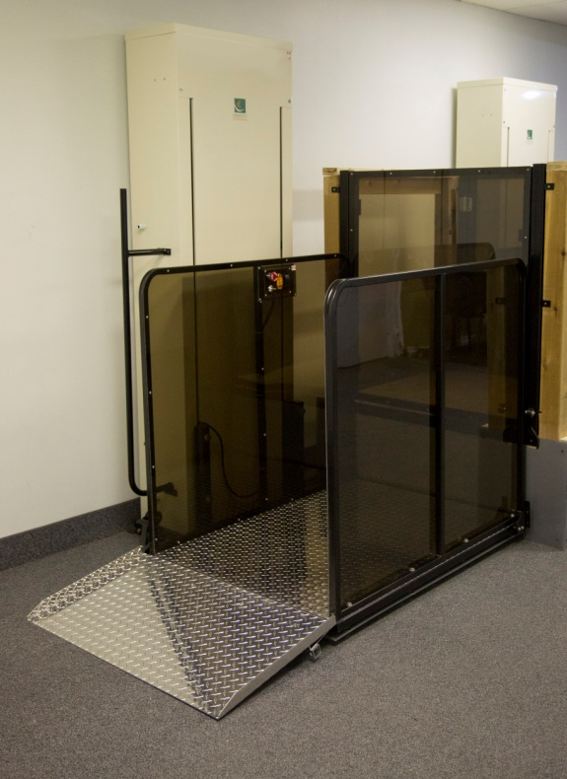
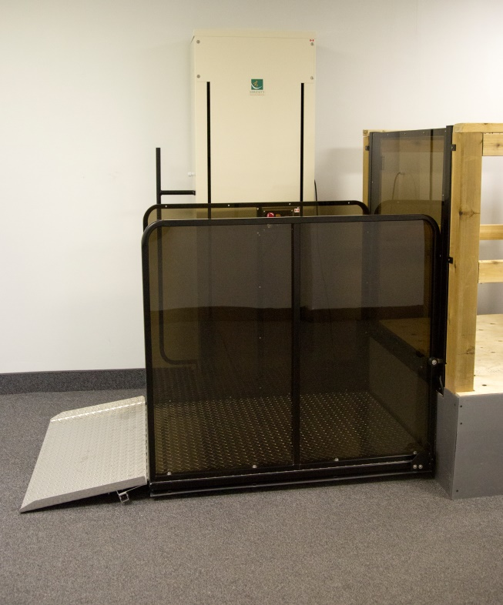
Standard Vertical Platform Lifts Collection
Product Code VPL-48028-AC VPL-48028-DC | Product Code VPL-48052-AC VPL-48052-DC | Product Code VPL-48072-AC VPL-48072-DC | Product Code VPL-480105-AC VPL-480105-DC
Overall Footprint Including Ramp 52 -1/4” x 68” | Overall Footprint Including Ramp 52 -1/4” x 68” | Overall Footprint Including Ramp 52 - 1/4” x 68” | Overall Footprint Including Ramp 52 -1/4” x 68”
Lifting Height: 28 Inches | Lifting Height: 52 Inches | Lifting Height: 72 Inches | Lifting Height: 105 Inches

Slide 8
Standard Vertical Platform Lifts Collection
Specifications | Product Code VPL-48028 | Product Code VPL-48052 | Product Code VPL-48072 | Product Code VPL-480105
Platform Size: Inside Outside | 34” x 48” 36” x 48” | 34” x 48” 36” x 48” | 34” x 48” 36” x 48” | 34” x 48” 36” x 48”
Maximum Lifting Height: Weight Capacity: | 28” 750 lbs | 52” 750 lbs | 72” 750 lbs | 105” 750 lbs
Motor Drive | 1 hp AC and VDC Acme Screw Drive | 1 hp AC and VDC Acme Screw Drive | 1 hp AC and VDC Acme Screw Drive | 1 hp AC and VDC Acme Screw Drive
Safety | Emergency Stop Safety Under – Pan Manual Lowering | Emergency Stop Safety Under – Pan Manual Lowering | Emergency Stop Safety Under – Pan Manual Lowering | Emergency Stop Safety Under – Pan Manual Lowering
Ramp | Manual Auto | Manual Auto | Manual Auto | Manual Auto
What Separates Us From The Rest | Light Weight Aesthetically pleasing Easy To Install 49” Tower Height Perfect For The Garage Stainless Steel Hardware Poly Carbonate side walls for added durability Aluminum Platform Field reversible Built to last | Light Weight Aesthetically Pleasing Easy To Install Stainless Steel Hardware Polycarbonate side walls for added durability. Aluminum Platform Field reversible Built to Last | Light Weight Aesthetically Pleasing Easy To Install Stainless Steel Hardware Polycarbonate side walls for added durability. Aluminum Platform Field reversible Built to Last | Light Weight Aesthetically Pleasing Easy To Install Stainless Steel Hardware Polycarbonate side walls for added durability. Aluminum Platform Field reversible Built to Last

Slide 9
STANDARD (48” Platform) Vertical Platform Lifts Lifting Heights Available 28”,52”, 72” & 105”
Removable Top Cover & Front Cover For Ease Of Access
Up & Down Toggle & Emergency Stop Button
52” Unit Only Weighs 350 lbs.
Polycarbonate
UV protected Side panels.
High Grade Powder
Coating
Stainless steel Nuts & Bolts
Available:
Landing Gate with Mechanical Lock.
Landing Gate with Electric Lock includes built in call-send, rocker switch and key switch
20” Autofold Ramp
750 lb lifting capacity
Field reversible LH to RH, RH to LH
Safety pan to prevent downward movement in case of an obstruction

Slide 10
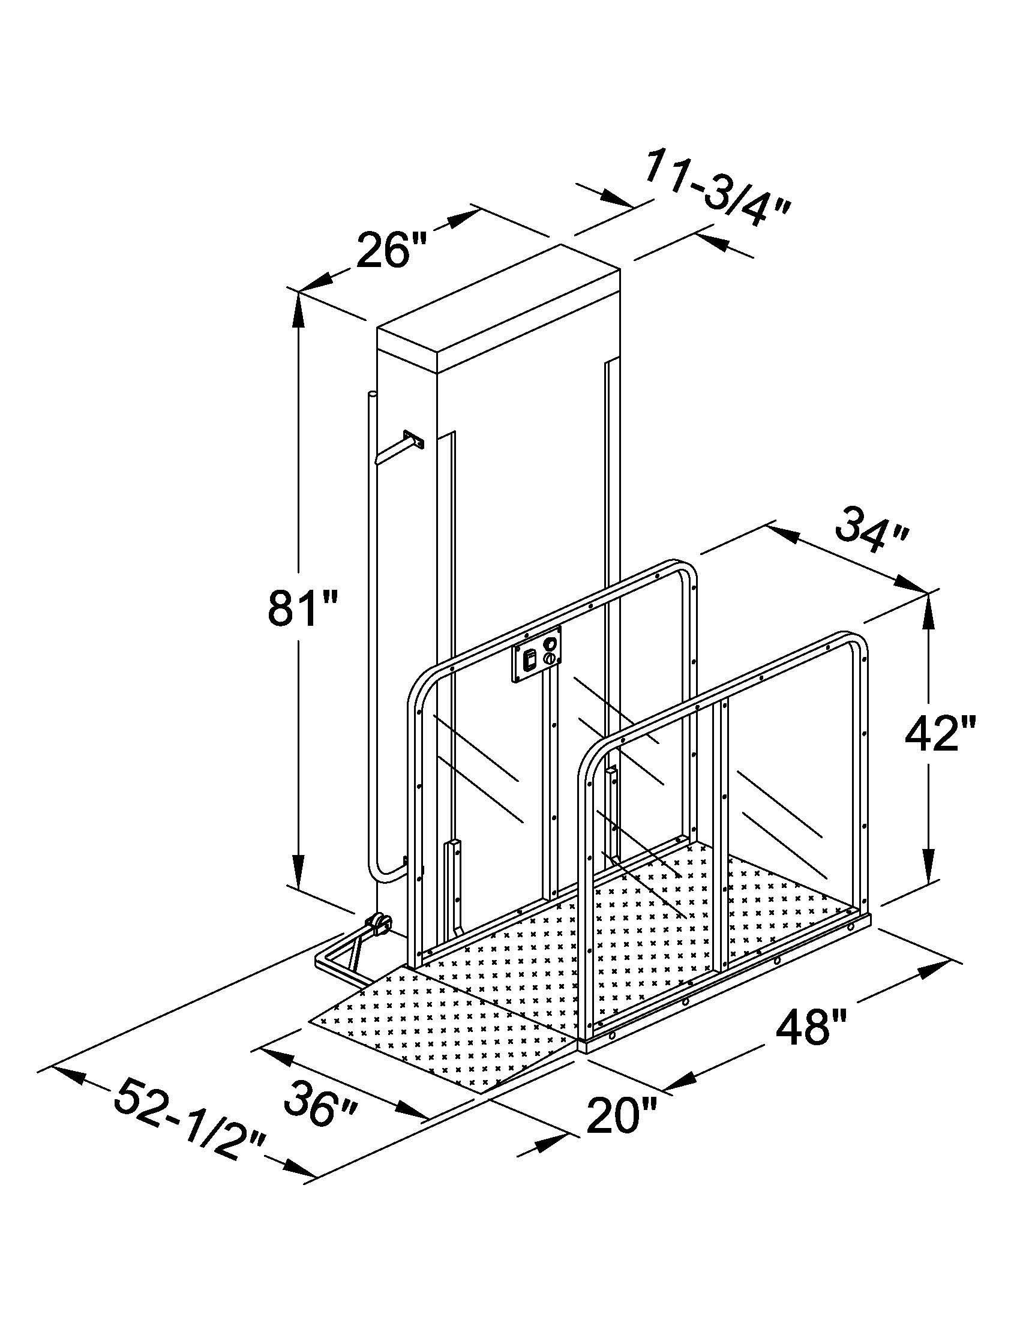
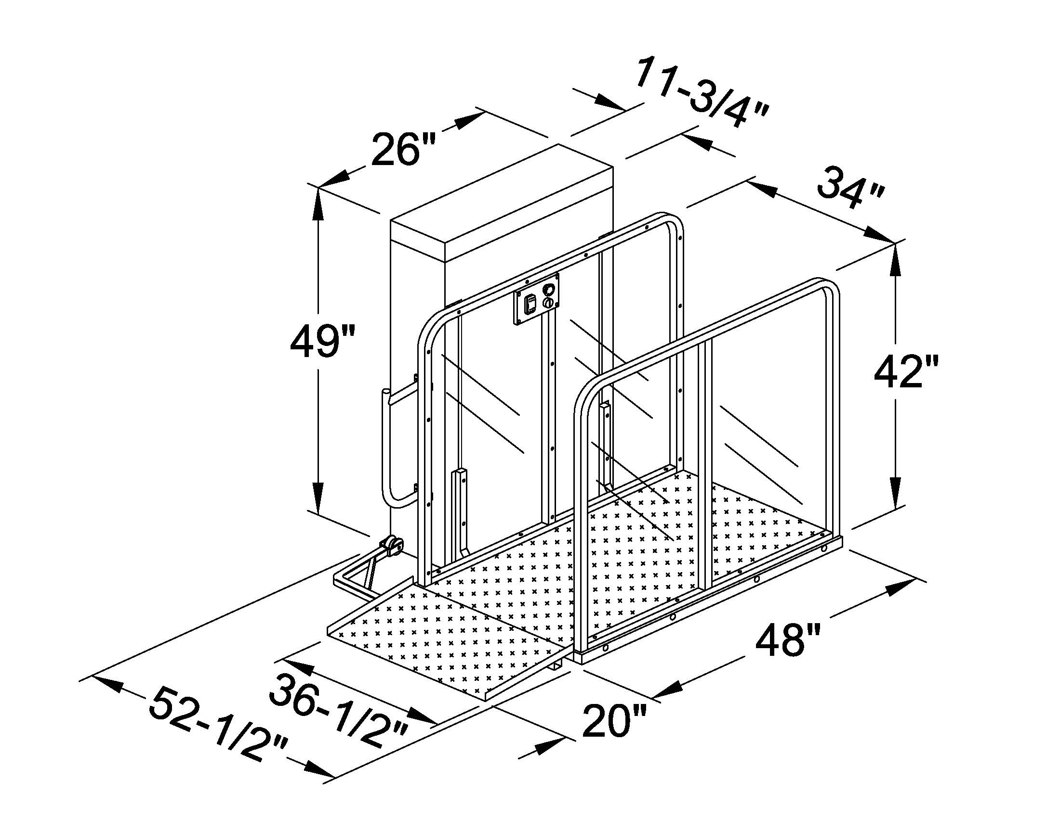
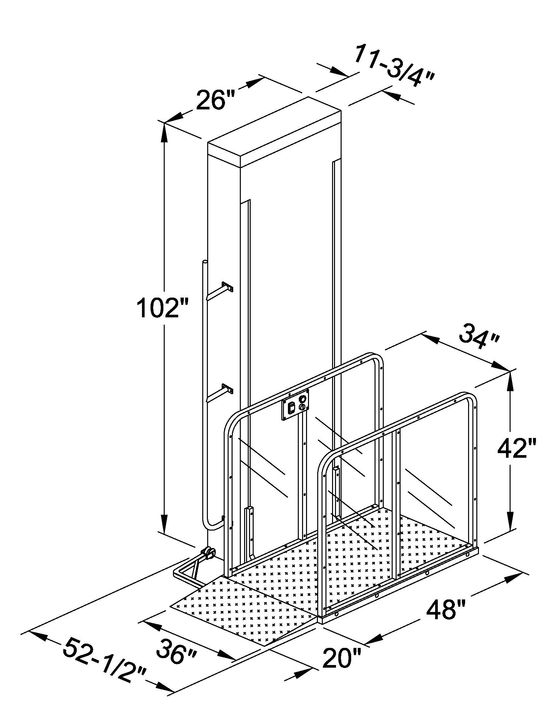
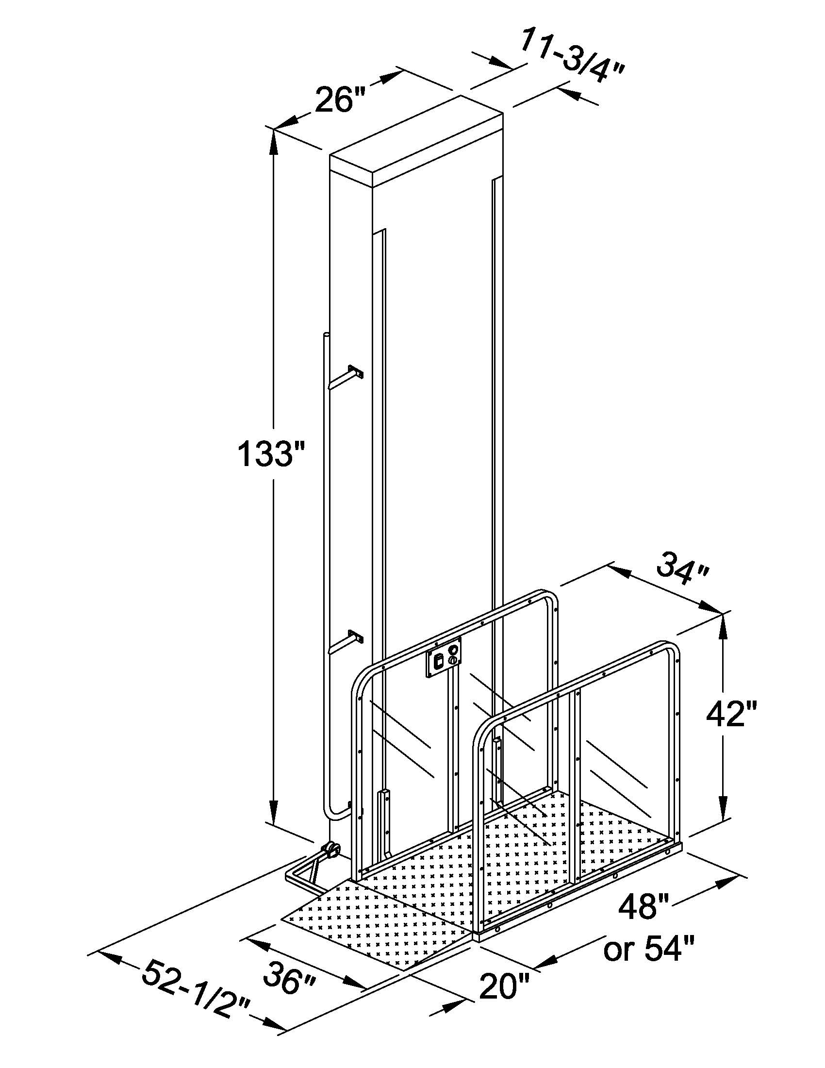
Standard Vertical Platform Lifts Line Drawings With Dimensions
VPL-48028
28” Travel >>>>>
VPL-48052
52” Travel >>>>>
VPL-48072
72” Travel >>>>>
VPL-480105
105” Travel >>>>>

Slide 11
Standard Vertical Platform Lifts Product Codes & Description
Products Code | Description
VPL-48028-AC | AC Inclinator Serenity Standard VPL, 36" x 48” Platform, 49” Tower Height, 28” Lifting Height, 750lb Weight Capacity.
VPL-48028-DC | DC Inclinator Serenity Standard Battery Operated VPL, 36" x 48” Platform, 49” Tower Height, 28” Lifting Height, 750lb Weight Capacity. (Batteries Not Included)
VPL-48052-AC | AC Inclinator Serenity Standard VPL, 36" x 48” Platform, 81” Tower Height, 52” Lifting Height, 750 lb Weight Capacity.
VPL-48052-DC | DC Inclinator Serenity Standard, Battery Operated VPL, 48” Platform, 81” Tower Height, 52” Lifting Height, 750 lb Weight Capacity.(Batteries Not Included)
VPL-48072-AC | AC Inclinator Serenity Standard VPL, 36" x 48” Platform, 102” Tower Height, 72” Lifting Height, 750 lb Weight Capacity
VPL-48072-DC | DC Inclinator Serenity Standard, Battery Operated VPL, 36" x 48” Platform, 102” Tower Height, 72” Lifting Height, 750 lb Weight Capacity. (Batteries Not Included)
VPL-480105-AC & DC | AC or DC Inclinator Serenity Standard VPL, 36" x 48” Platform, 135” Tower Height, 105” Lifting Height,750 lb Weight Capacity
The Inclinator Serenity Standard VPL
Inside Measurement of 34” x 48” Aluminum Platform, powder Coated Steel Side rail & Polycarbonate Panels.
This unit is not field reversible from straight through to 90 degree.
The Standard Lift is available in a 90 Degree Configuration for an up charge of $150.

